Slide 1
Welcome to the 2022-2023 School Year

Slide 2
Things that must be done before students can Practice!
Current Physical on File (good for 3 years)
Eligibility Brochure turned in (each year)
Medical Emergency (Fill out JMC Parent Access)
Sports Fee Paid: $100 fee 7-12 Sports. $50 fee for Speech and One Act Play $275 Individual max, $400 family max.
Possess the specific sports handbook
Access to LA Overview of School Policies found on the Activities Director’s website
Access to a Parent / Student Co-Curricular Handbook on Activities Director’s website

Slide 3
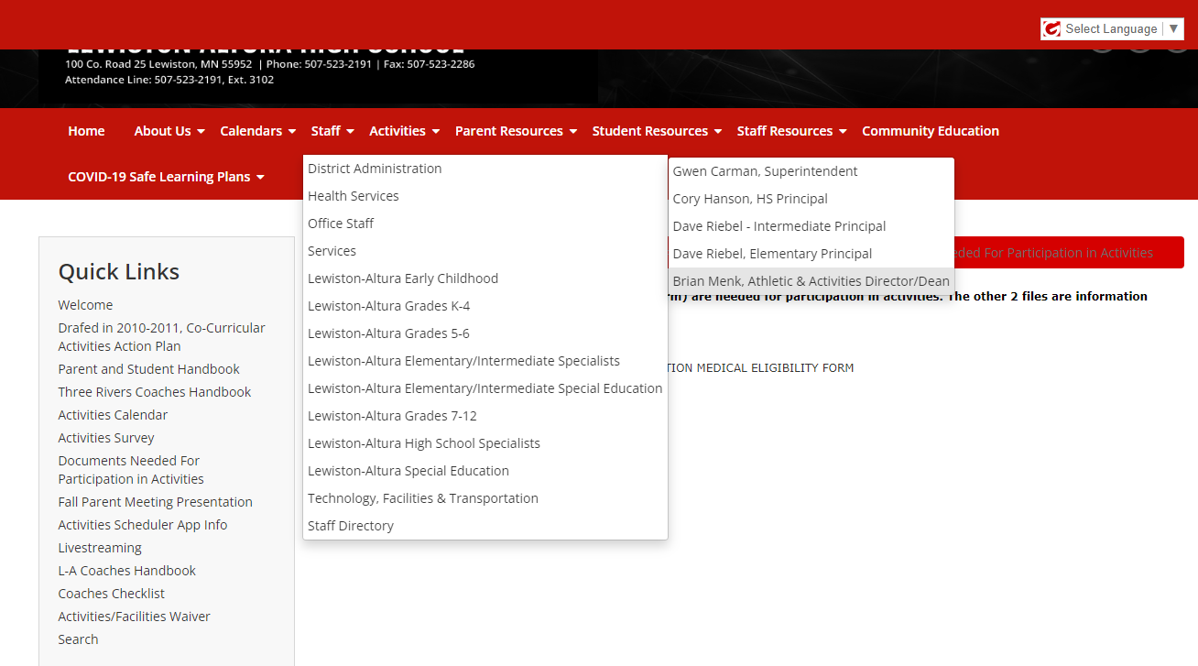
Access my website by clicking on Staff, then District Administration

Slide 4
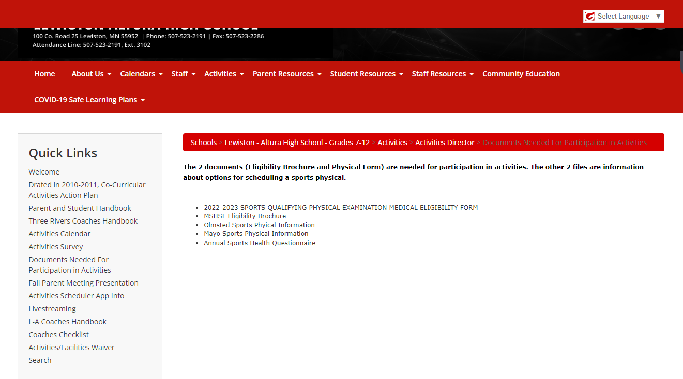
Click to access needed documents

Slide 5
Online activities registration
The District has purchased a program for online registration and payments for activities.
Payments can be made online with a 3% + 30 cents convenience fee is paid to the service we are using. You are still able to pay at the HS office if you wish.
ALL forms (other than the physical form) MUST be filled out online. Paper forms are not going to be accepted. Laptops can be made available to be used at the high school if you do not have access at home.
This program is not available yet, but will be by August 10, so you do not need to register, turn in forms, or pay at the office. All of this can be done online.
The only thing that will still need to be done as it has in the past is the Sports Physical. That form needs to be taken to your physician to be filled out and signed. You will still need to turn that into the HS office. This is only needed every 3 years.

Slide 6
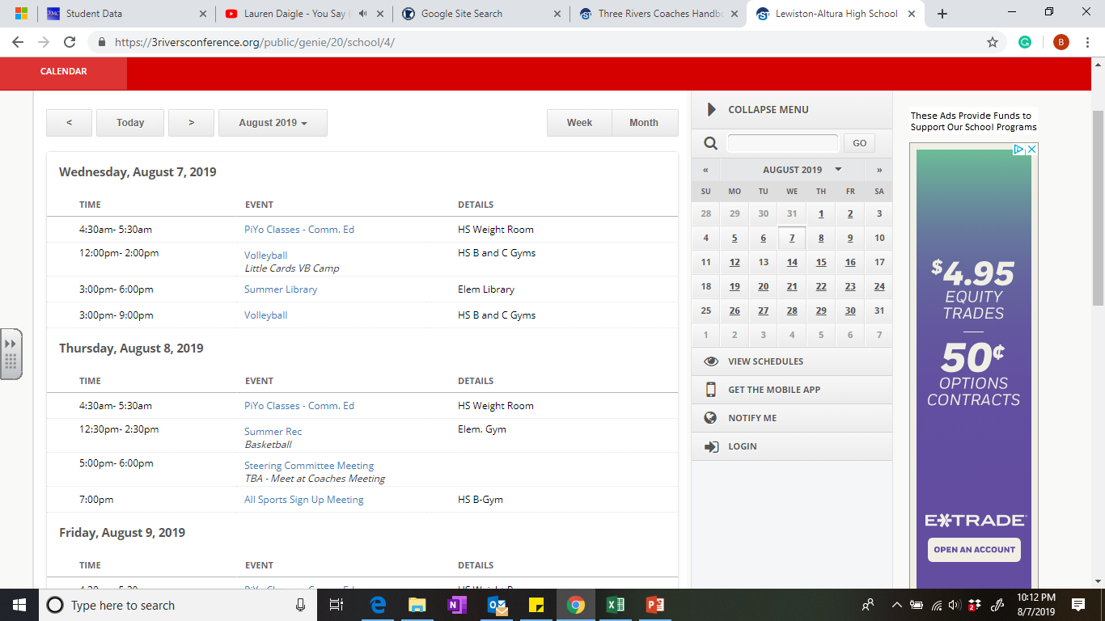

Don’t forget to sign up for notifications!!
This is the only way you would find out
About cancellations and game changes.

Slide 7
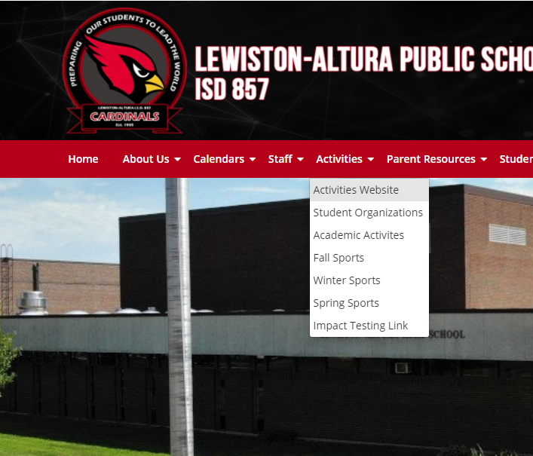
Activities Website
Link
This site is the place you can access schedules, scores, rosters, and other activities information.

Slide 8
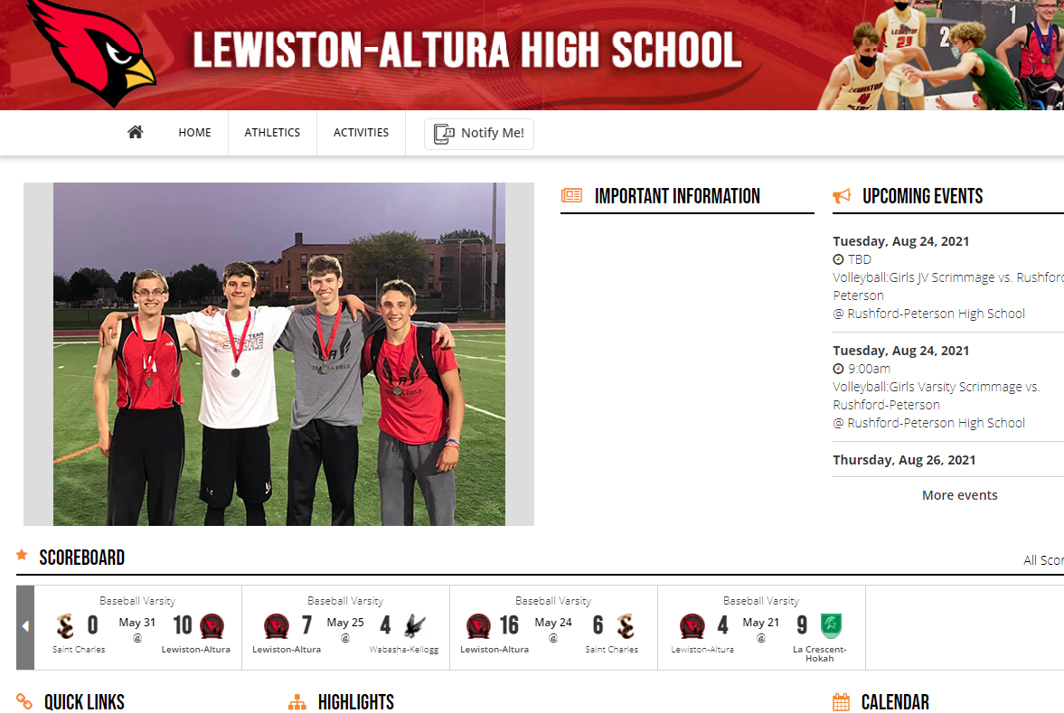

Slide 9
Benefits of Co-curricular or Education-based Activities
Activities Support the Academic Mission of Schools. They are not a diversion, but rather an extension of a good educational program. Students who participate in activity programs tend to have higher grade-point averages, better attendance records, lower dropout rates and fewer discipline problems than students generally.
Activities are Inherently Educational. Activity programs provide valuable lessons and skills for practical situations – like teamwork, fair play, and hard work. Through participation in activity programs, students learn self-discipline, build self-confidence and develop skills to handle competitive situations. These are qualities students need if they are to become responsible adults, productive citizens and skilled professionals.

Slide 10
Activities Promote Health and Well-being. Mental and physical health are improved by through activities. Self-concept, self-image, physical activity, and weight management are a few of these health benefits realized through activity participation.
Activities Foster Success in Later Life. Participation in high school activities is often a predictor of later success – in college, a career and becoming a contributing healthy member of society.

Slide 11
Common Questions
If a student comes to school late and says they were late due to illness… they can not participate in practice or participate in a game that day.
Students are aloud to ride home from a sports contest with a parent providing the parent hands a signed note to the coach before leaving. If any other adult other than a parent wants to drive the student home from an away event, this must be approved ahead of time by the Principal or AD in writing.
A student is required to keep their belongings locked up in the “locker rooms.” The school will no longer reimburse locker locks and keep combination for lockers in the office. However the school will still sell locks to students at school purchase cost. (cost $5 dollars per lock)

Slide 12
ACADEMIC REQUIREMENTS FOR PARTICIPATION IN ACTIVITIES
Extra-Curricular Activity and Minnesota State High School League Academic Eligibility
Lewiston-Altura High School sets high expectations for student academic achievement. We offer a large array of Minnesota State High School League (MSHSL) activities and Non-MSHSL opportunities for students to participate in beginning in grade 7 and going through grade 12 to support continued development of our students. All participants involved in activities are students first and activity participants second. Below is a list of current activity offerings that complement our educational course offerings. Students interested in an opportunity not listed on the charts below need to speak to the Activities Director about possibility of adding new activities.

Slide 13
Class I MSHSL Activities
Fall | Winter | Spring
Boys Soccer | Girls Nordic Skiing | Baseball
Girls Soccer | Boys Basketball | Boys Golf
Boys Cross Country | Girls Basketball | Girls Golf
Girls Cross Country | Dance (Jazz and High Kick) | Speech (If attending competitions)
Football | Wrestling | Softball
Girls Volleyball | One Act Play | Boys Track
 |  | Girls Track
Non-MSHSL Activities
Fall | Winter | Spring
Fall Play | Junior High Play | Musical
Math League | Knowledge Bowl | Supermileage
Year round Activities: NHS, FFA, Student Council, HOSA, and Trap League

Slide 14
MSHSL and LAHS Definitions of Eligibility
The Minnesota State High School League requires schools to demonstrate that as activity participants, “Students must be on track to meet the school’s graduation requirements in six years (12 consecutive semesters) beginning with the first day of attendance in the 7th grade.” (Bylaw 103.00) As a school, we believe it is important for all activity participants to be meeting academic criteria, not just those involved in MSHSL activities.
Lewiston-Altura High School will define on track to graduate for all MSHSL and Non-MSHSL activities in two ways: initial eligibility and continuing eligibility.

Slide 15
Initial Eligibility for all MSHSL and Non-MSHSL Activities (9th - 12th Only) - (Since the policy will be new for the 2021-22 school year, the first period of ineligibility will occur at the end of 1st semester of the 2021-22 school year.)
For 9th - 12th grade students to meet initial eligibility criteria, students must obtain minimum credit requirements to be on track to graduate. Graduation requirements will be reviewed prior to the start of each school year (all 9th grade students will be eligible for fall participation) and at the end of first semester. The chart below provides a summary of initial eligibility criteria for activity participation based upon the board approved graduation requirement of 30 credits.
 | Credits to Begin the Year | Credits after First Semester
9th | 0 | 2
10th | 6 | 10
11th | 14 | 18
12th | 22 | 26
Students that fall below the credit requirements are not eligible to participate in an activity until they obtain the minimum credit requirement. Students who are not meeting eligibility criteria can become eligible through completion of credit recovery contracts by attending after school, during school or summer school credit recovery opportunities. Students that are behind on credits will not be allowed to practice, attend games, or participate in an activity in any capacity until they have reached the required number of credits for their grade and grading period.

Slide 16
Continuing Eligibility- Class I MSHSL and Non-MSHSL Activities (Since the policy will be new for the 2021-22 school year, the first period of suspension will occur at the end of the 1st quarter of the 2021-22 school year.)
Grades 9-12: Students in grades 9-12 that fail one or more classes at the quarter mark will serve a suspension from all activities. One week of suspension will occur for each F on the quarter report card related to a period class or two weeks for a block course. No suspension will exceed two weeks. Students are required to attend all practices and games for activities they are registered for during the suspension or attend credit recovery with their advisor’s permission, but are not allowed to practice or participate in competitions with the activity during the suspension. Suspensions from all Class I and Non-MSHSL will begin the first day of the new quarter and run for 7 consecutive calendar days per F, not to exceed 14 days of suspension. Students and advisors will be notified of suspensions on the first day of the new quarter after all grades have been posted.
Quarter 1 grades may impact participation in fall postseason participation and/or initial participation in winter sports.
Quarter 2 grades may impact winter activity participation.
Quarter 3 grades may impact winter activity participation and/or initial spring activity participation.
Quarter 4 grades may impact spring activity postseason participation and/or fall activity participation the next school year.

Slide 17
Grades 7 and 8: Students in grade 7 or 8 that fail one or more classes at the quarter mark will serve a one week suspension from all activities. Students are required to attend all practices and games for activities they are registered for during the suspension, but are not allowed to practice or participate in competitions with the activity during the suspension. Suspensions from all Class I and Non-MSHSL will begin the first day of the new quarter and run for 7 days consecutive calendar days. Students and advisors will be notified of suspensions on the first day of the new quarter after all grades have been posted.
Quarter 1 grades will impact participation in winter activities.
Quarter 2 grades will impact participation in winter activities.
Quarter 3 grades will impact participation in spring activities.
Quarter 4 grades will impact participation in fall activities for students going into 8th grade.

Slide 18
Steps for Parents/Students to Follow to Solve a Concern or Issue
Make it a point to NOT try to solve issues just before or just after a game/contest!
First, student should talk to the coach directly. Not saying that the outcome will be mutually agreed upon but will result in a better understanding of eachother’s view point.
Second, if not resolved student and parent should meet with coach together.
Third, if not resolved the parent, student, coach and AD should meet.

Slide 19
Helpful things to know and do as a parent and student
Get to know the coach.
Know the team and school policies found in the Team and Coaches Handbooks.
Know what the Down and Off rules are.
Know the team schedule and bus departure times. (found on LA activities calendar)
Sign Up for the “Notify Me” option on the activities calendar Site for up to date changes.
Support the team and understand the importance of team / student roles.
Know your student’s coach’s intent for communication (how often and content)

Slide 20
Activites
Steering Committee
What is the Steering Committee?
The Steering Committee, formed in 2018 and is an Advisory Council to the Activities Department.
What is the Steering Committee’s Purpose?
The Steering Committee seeks to maintain and improve upon current Activities Department policies and procedures for the purpose of providing best practices and offering and teaching lifelong skills through co-curricular involvement.
Who is on the Steering Committee?
Brein Maki, Matthew Wilmes, Michael VanderPlas, Tanya LeJeune, Sarah Sommer, Superintendent Carman, Dr. Hanson, and Brian Menk

Slide 21
Activity fees
- All L- A Staff and L-A/St. Johns/Silo students (with an ID): FREE
-Adults (Out of HS through age 64): $7.00
-Adults ages 65+: FREE
-Visiting Students: $4.00
One Adult Fall or Winter Season Pass for all home games in that season: $50.00

Slide 22
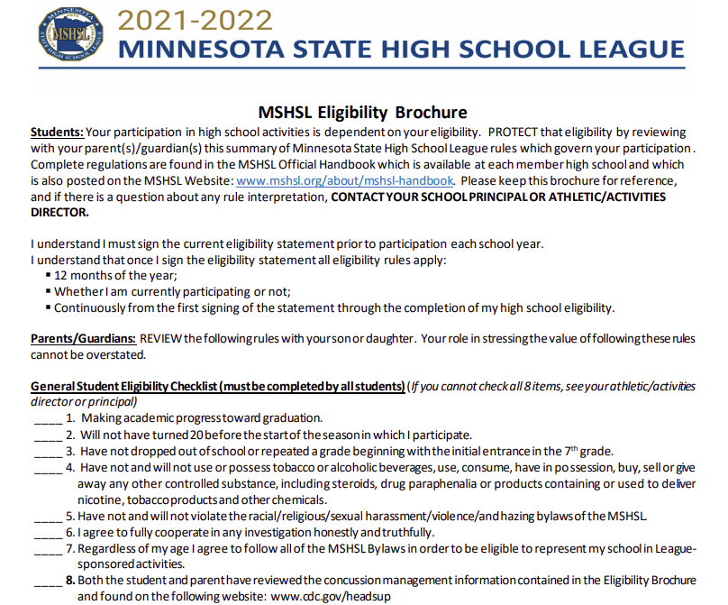
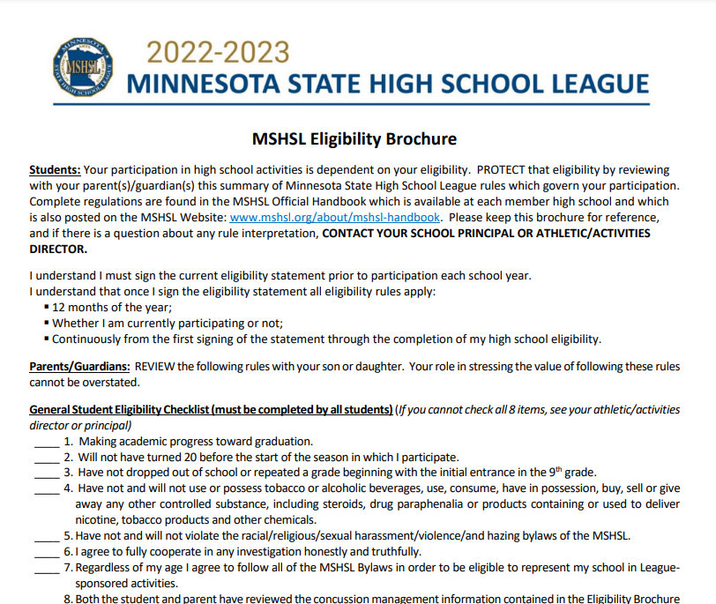
Ensure that you read and understand the eligibility brochure!!!!!

Slide 23

Supervise your young children!

Slide 24
LA Booster Club
Become a member
  Stop by and see Tara Mundt and/or Robin Randall to find out how.
There is a huge need for parents to sign up to work 1 two hour shift per child each season.
They are Rock Stars for our community

Slide 25
In the summer of 2019, messaged 26 current and former Lewiston-Altura student-athletes. I simply asked them 2 questions…..
As an athlete, what do you expect from your coach?
As an athlete, what do you expect from your parents?

Slide 28
Quote from Justin Puetz
I expect my coach(s) to lead with principles. I would expect them to lay out a set of expectations of how each player and coach are to act as a member of the team. I expect them to lead from the top down. And most importantly, how to teach us boys to become men. It's not just a seasonal thing in my opinion, a coach plays a very important role in a persons life, in and out of season, and even beyond high school.
Personally I would expect my parents to parent and my coach to coach. I would never want them to complain to the coaches or try to get them to fight my battles for me. The can talk with me and then I can address the coaches. I would expect my parents to respect me enough to listen to my requests.

Slide 29
Goals vs purpose
Goals are performance based
  Winning games
  Conference and section championships
  Individual performance goals
Purpose is based on life lessons
  Why a student plays
  Why a coach coaches

Slide 30
Individual sport meetings
Football: Cafeteria
Cross country: C wing classroom
Volleyball: C gym dance: Classroom TBD

Slide 31
Thank You!!

